Slide 1
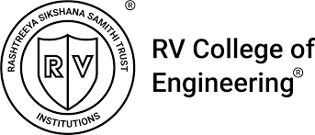
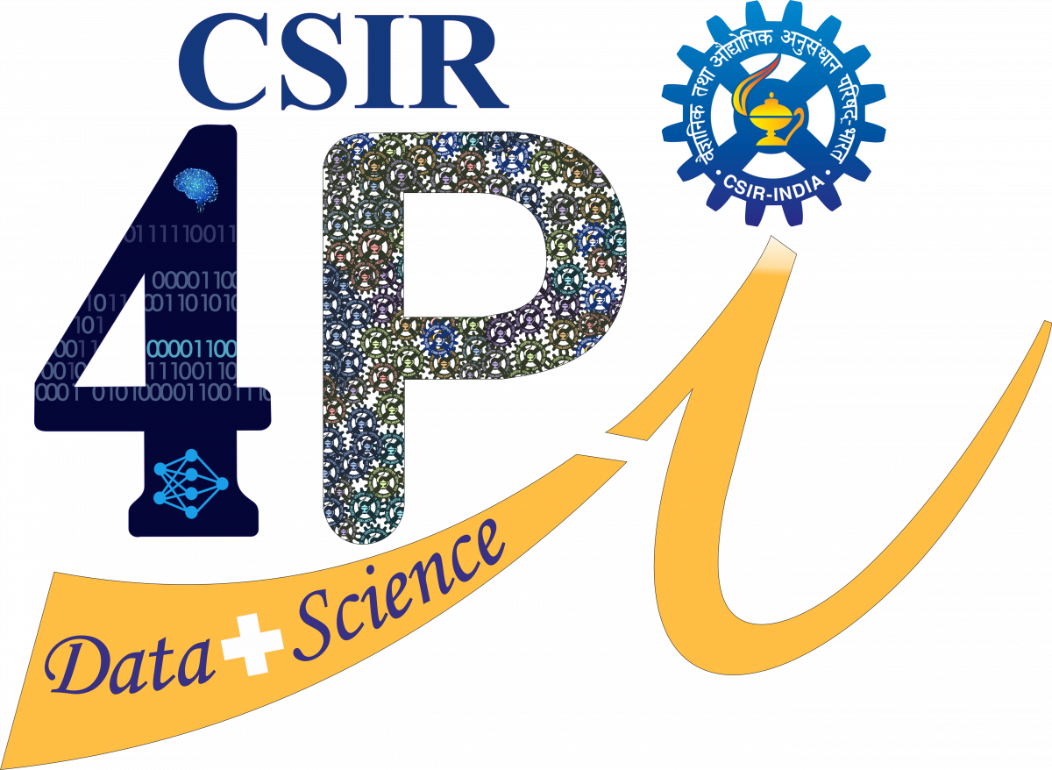




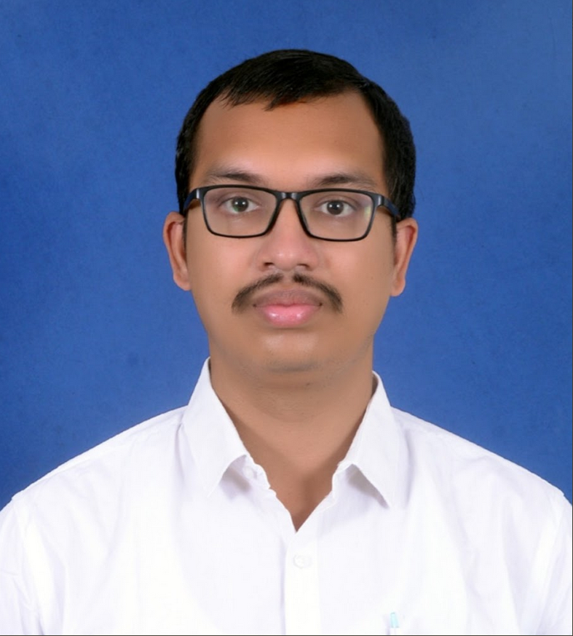
MITHUN BABU
Mithun is a Scientist in the Big Data Research and Supercomputing Division (BRSD) at CSIR-Fourth Paradigm Institute (CSIR-4PI), Bengaluru. He is a roboticist whose current research spans Robotics, Large Language Models, Tactile Sensing, Reinforcement Learning, and AI applications in Agro-technologies. He holds a B.Tech. in Mechanical Engineering from the National Institute of Technology (NIT), Rourkela, and an M.S. (by Research) from the Robotics Research Center, International Institute of Information Technology (IIIT), Hyderabad, where his thesis focused on autonomous vehicles. Beyond research, Mithun is an avid racing enthusiast and a history buff.

